Slide 1
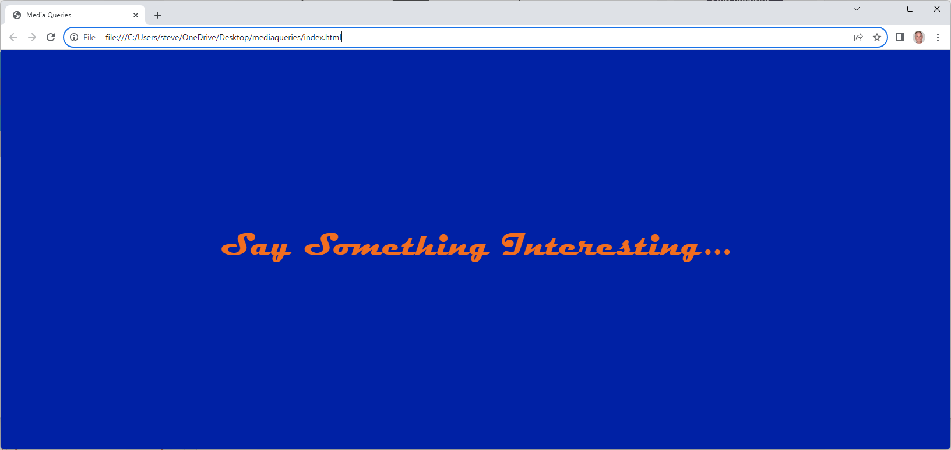
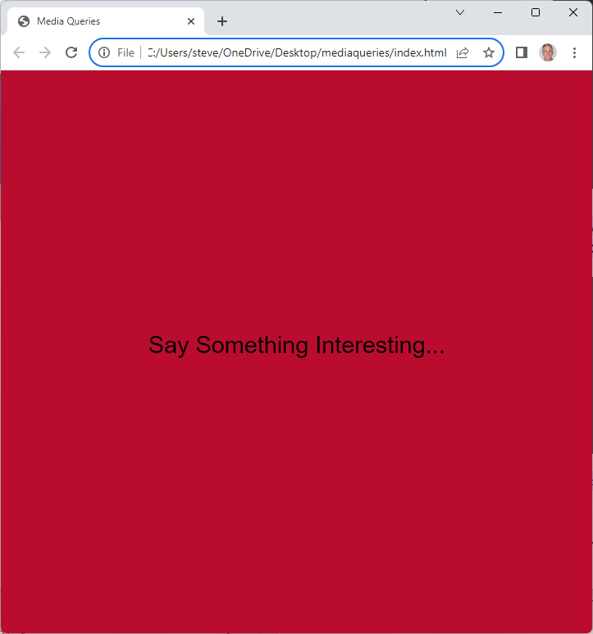
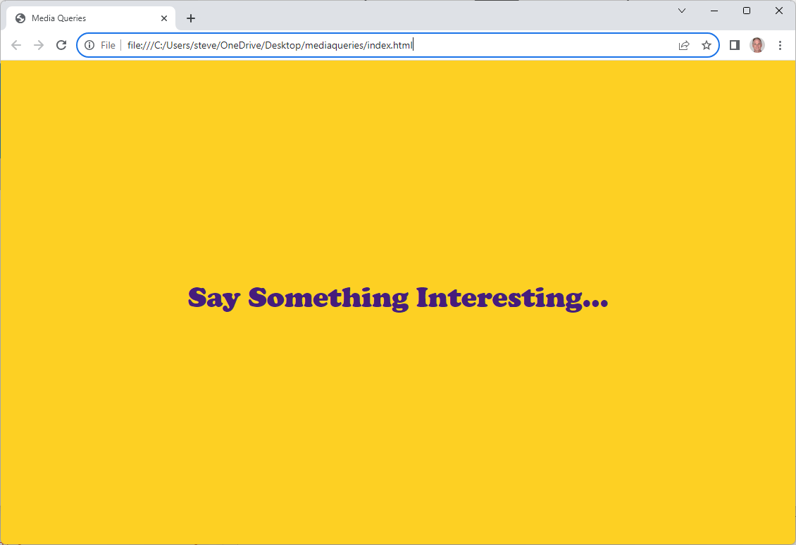
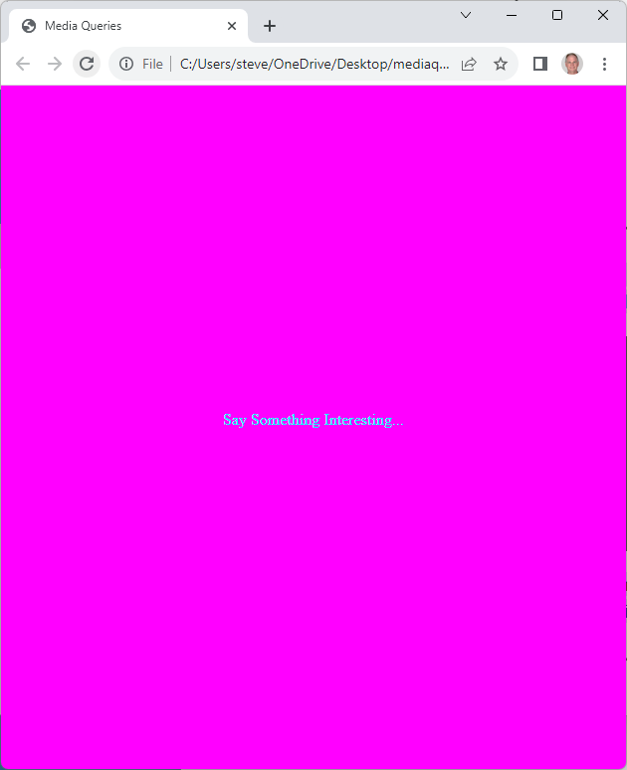
Lab: Media Queries
Changing background color based on <body> width
1

Slide 2
Lab: Media Queries
Download, unzip ‘mediaqueries.zip’
Open ‘index.html’ in text editor and browser
Open ‘css/styles.css’ in text editor
<!DOCTYPE html>
<html lang="en">
<head>
<meta charset="utf-8">
<title>Media Queries</title>
</head>
<body>
</body>
</html>
2

Slide 3
Lab: Media Queries
Add the viewport meta tag and link to stylesheet
<!DOCTYPE html>
<html lang="en">
<head>
<meta charset="utf-8">
<title>Media Queries</title>
</head>
<body>
</body>
</html>
<!DOCTYPE html>
<html lang="en">
<head>
<meta charset="utf-8">
<meta name="viewport" content="width=device-width, initial-scale=1.0">
<link href="css/styles.css" rel="stylesheet">
<title>Media Queries</title>
</head>
<body>
</body>
</html>
3

Slide 4
Lab: Media Queries
Add the text ‘Say Something Interesting…’
Save the page; not much to see yet
<!DOCTYPE html>
<html lang="en">
<head>
<meta charset="utf-8">
<meta name="viewport" content="width=device-width, initial-scale=1.0">
<link href="css/styles.css" rel="stylesheet">
<title>Media Queries</title>
</head>
<body>
</body>
</html>
<!DOCTYPE html>
<html lang="en">
<head>
<meta charset="utf-8">
<meta name="viewport" content="width=device-width, initial-scale=1.0">
<link href="css/styles.css" rel="stylesheet">
<title>Media Queries</title>
</head>
<body>
<p>Say Something Interesting...</p>
</body>
</html>
4

Slide 5
Lab: Media Queries
Open ‘css/styles.css’
Add default background color of magenta; color of cyan;
/*Styles for mediaqueries*/
/*Styles for mediaqueries*/
body {
background: magenta;
color: cyan;
}
5

Slide 6
Lab: Media Queries
Write three media queries or ‘conditional style rules’
body {
background: magenta;
color: cyan;
}
body {
background: magenta;
color: cyan;
}
@media screen and (min-width: 700px){
body {
background: #ba0c2f;
}
}
@media screen and (min-width: 1100px) {
body {
background: #fdd023;
}
}
@media screen and (min-width: 1500px) {
body {
background: #0021a5;
}
}
6

Slide 7
Lab: Media Queries
As monitor size increases, different media query applies
all
print
screen
speech
and
or
property
value
@media screen and (min-width: 700px){
body {
background: #ba0c2f;
}
}
7

Slide 8
Lab: Media Queries
RWD uses specificity: newest style wins
0
300
700
1100
1500
body {
background-color: magenta;
}
@media screen and (min-width:700px){
body {
background: #ba0c2f;
}
}
@media screen and (min-width: 1100px) {
body {
background: #fdd023;
}
}
@media screen and (min-width: 1500px) {
body {
background: #0021a5;
}
}
8

Slide 9
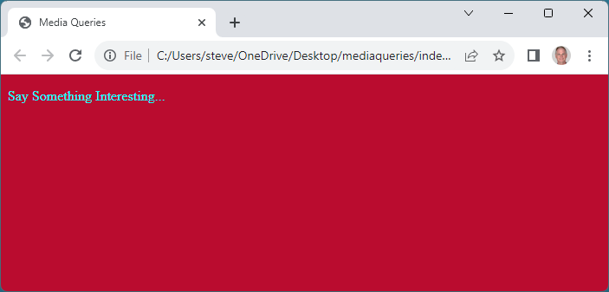
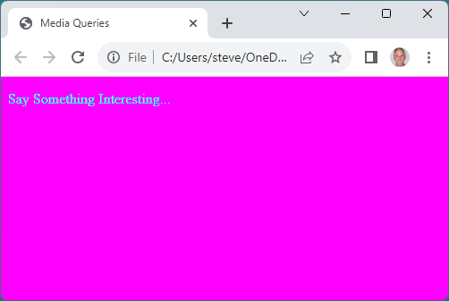
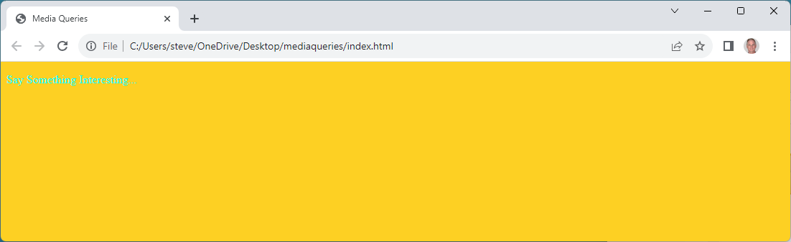
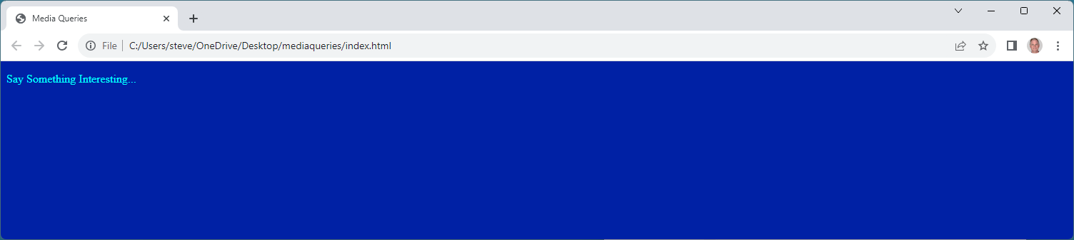
Lab: Media Queries
When done, background color of browser changes with size
9

Slide 10
Lab: Media Queries
Style the appearance of the text
@media screen and (min-width:600px) {
body {
background-color: #ba0c2f;
}
}
@media screen and (min-width:700px) {
body {
background-color: #ba0c2f;
}
p {
font-size: 2em;
font-family: "Snap ITC";
color: black;
}
}
10

Slide 11
Lab: Media Queries
Style the appearance of the text
@media screen and (min-width: 900px) {
body {
background: #fdd023;
}
}
@media screen and (min-width: 900px) {
body {
background: #fdd023;
}
p {
font-size: 3em;
font-family: "Cooper Black";
color: #461d7c;
}
}
11

Slide 12
Lab: Media Queries
Style the appearance of the text
@media screen and (min-width: 1200px) {
body {
background: #0021a5;
}
}
@media screen and (min-width: 1200px) {
body {
background: #0021a5;
}
p {
font-size: 4em;
font-family: Magneto;
color: #f16e20;
}
}
12

Slide 13
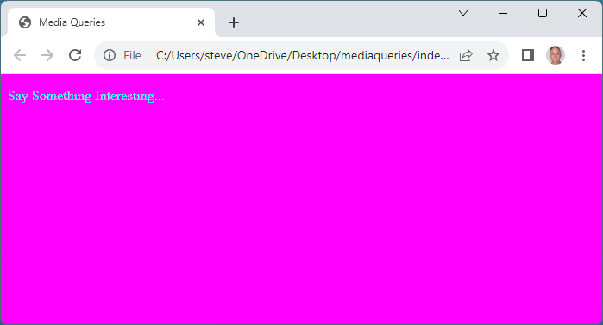
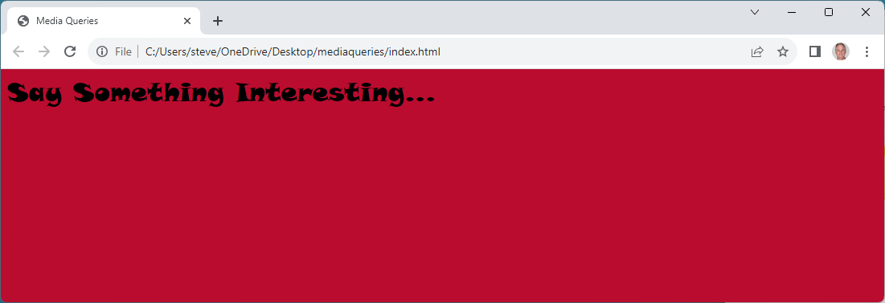
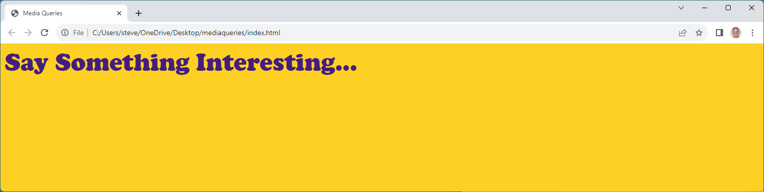
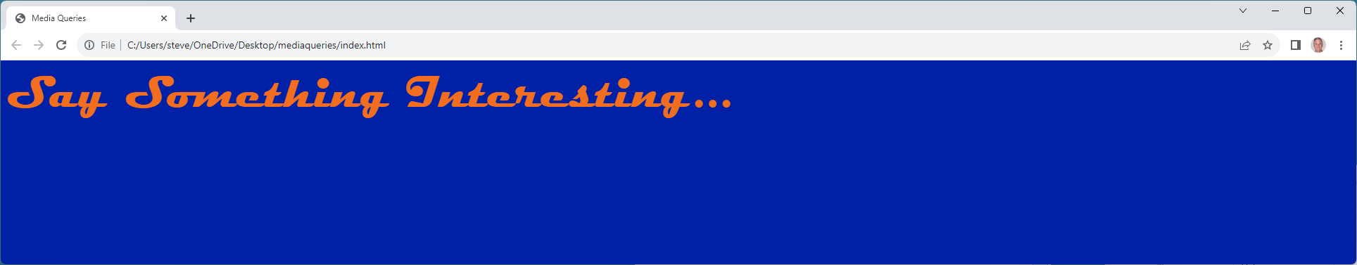
Lab: Media Queries
Style the appearance of the text
13

Slide 14
Lab: Media Queries
Center the text using flex
html {
height: 100%;
}
body {
height: calc(100% - 1em);
background: magenta;
color: cyan;
display: flex;
justify-content: center;
align-items: center;
}
body {
background: magenta;
color: cyan;
}
14

Slide 15
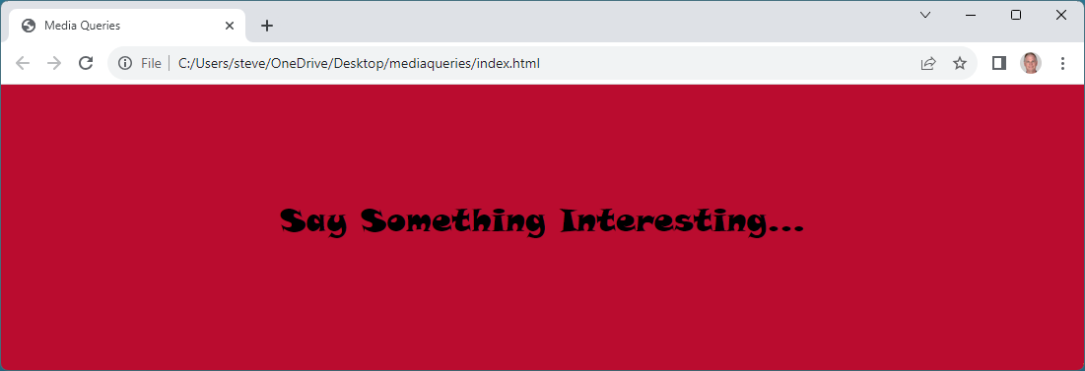
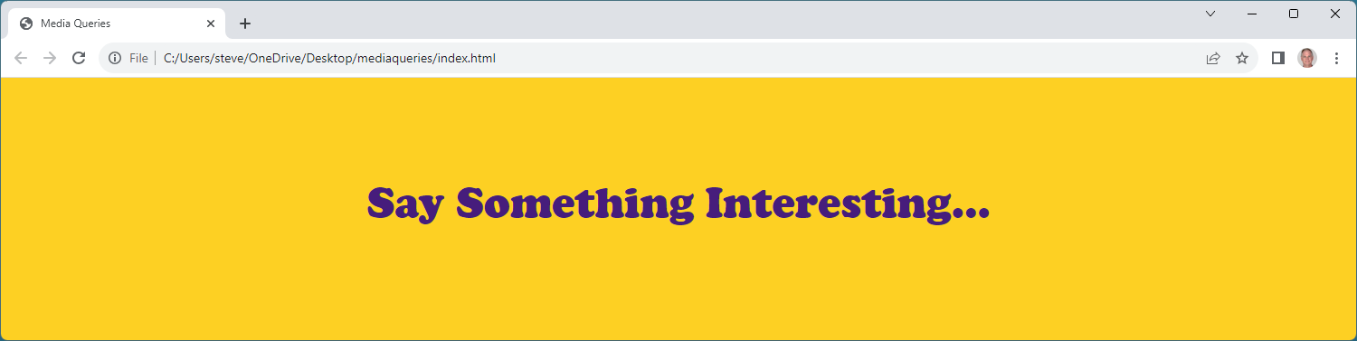
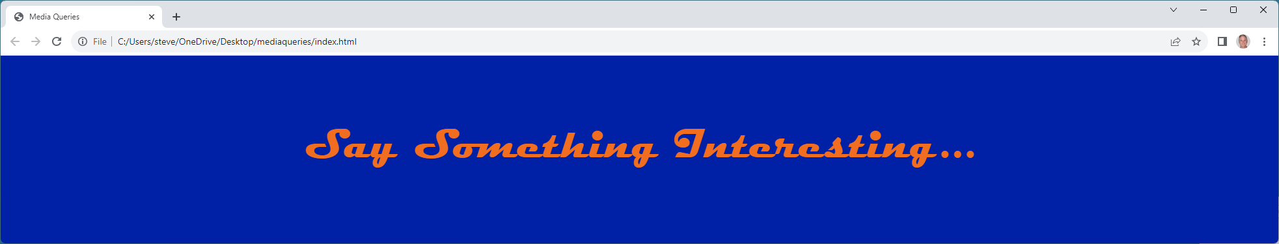
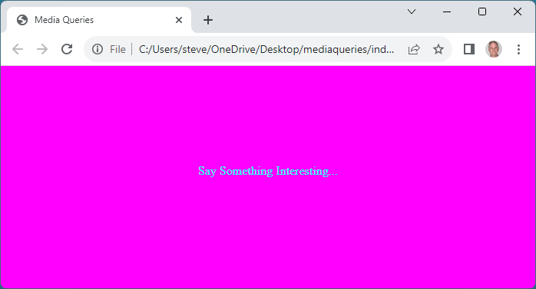
Lab: Media Queries
Save, open ‘mediaquery.html’ in your browser:
15

